Slide 1
Engineering Chemistry F. Y. B. Tech.
Dr. Jitendra Satam

Slide 2

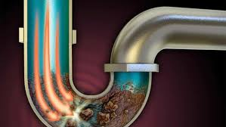
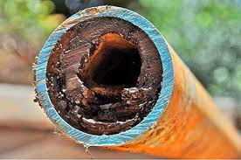
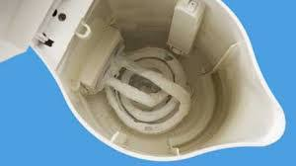
Hard water in industry

Slide 3
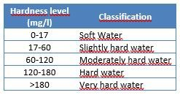
Classification of Hardness

Slide 4
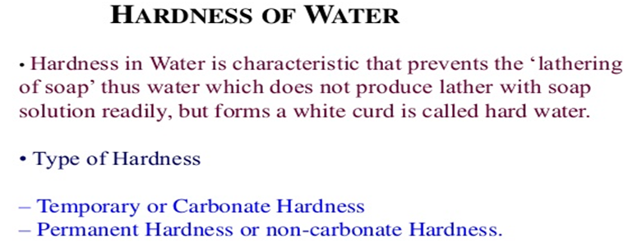
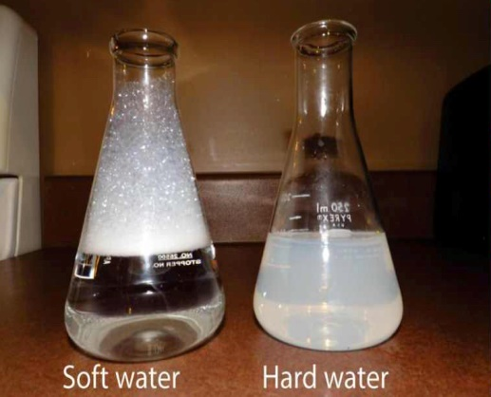

Slide 5
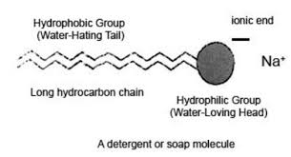
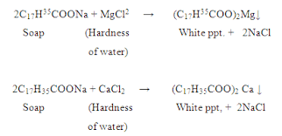
Reaction of Soap with Water

Slide 6
How to detect hardness?
When the water is treated with soap solution, if it prevents lathering and forms white scum, the water contains hardness. Or Water containing hardness, gives wine red colour with Eriochrome Black –T indicator.
Although water hardness usually measures only the total concentrations of calcium and magnesium (the two most prevalent, divalent metal ions), iron, aluminum and manganese may also be present at elevated levels in some geographical locations. The predominant source of magnesium is dolomite [Ca-Mg(CO₃)₂].

Slide 7
TYPES OF HARDNESS
Depending upon the types of dissolved salts present in water, hardness of water can be classified into two types:
Temporary Hardness
(Carbonate hardness or Alkaline hardness)
Permanent Hardness
(Non carbonate hardness or Non alkaline hardness)

Slide 8
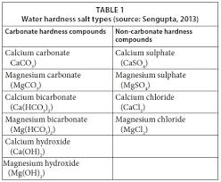
Types of Hardness

Slide 9
Temporary Hardness (or) Carbonate Hardness
(or) Alkaline Hardness
Temporary hardness is caused by carbonate, bicarbonate and hydroxide of calcium and magnesium ions in the water.
It can be removed by boiling water or by the addition of lime [Ca(OH)₂]
Boiling promotes the formation of carbonate from the bicarbonate and precipitates calcium carbonate out of solution, leaving water that is softer upon filtration and removal of residue.
Ca (HCO₃)₂→ CaCO₃ ↓+ H₂O + CO₂

Slide 10
Permanent Hardness or Non – Carbonate Hardness (or) Non – alkaline Hardness
Permanent hardness is hardness (mineral content) that cannot be removed by boiling.
It is usually caused by the presence of sulphates, chlorides, nitrates of calcium and magnesium and other metal ions which become more soluble on boiling.
Despite the name, permanent hardness can be removed using water – softener or ion-exchange column, where the calcium and magnesium ions are exchanged with the sodium ions in the column. It can be removed by
Lime – Soda process
Zeolite process

Slide 11
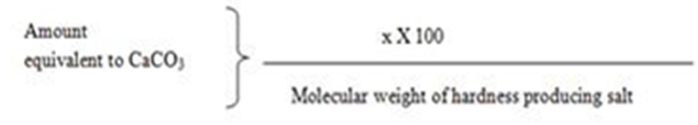
Expression of hardness in terms of
equivalents of CaCO₃
The concentrations of hardness producing salts are usually expressed in terms of equivalent amount of CaCO₃.
CaCO₃ is chosen as a standard because, Its molecular weight (100) and equivalent weight (50) is a whole number, so the Calculations in water analysis can be simplified.
It is the most insoluble salt, that can be precipitated in water treatment.
If the concentration of hardness producing salt is x mg/lit.

Slide 12
Expression of hardness in terms of equivalents of CaCO₃
CaCO₃ Equivalent Hardness (ppm) =
= Mass of Hardness Producing substance x Chemical equivalents of CaCO₃ / Chemical equivalents of Hardness causing salt.
How many grams of FeSO₄ dissolved per litre gives 210 ppm hardness?
Calculate temporary hardness and permanent hardness of water sample from the following data:
Mg(HCO₃)₂ = 16 mg/L, MgCl₂ = 19 mg/L, MgSO₄ = 2.4 mg/L, Mg(NO₃) ₂ = 2.96 mg/L, Ca(HCO₃) ₂ = 8.1 mg/L, SiO₂ = 16 mg/L

Slide 13
UNITS OF HARDNESS
Parts per million (ppm):
It is defined as the number of parts of CaCO₃ equivalent hardness per 1000000 parts of water.
Milligrams per litre (mg/lit):
It is defined as the number of milligrams of CaCO₃ equivalent hardness per 1 litre of water.

Slide 14
Clarke’s degree (ºCl)
It is defined as the number of parts of CaCO₃ equivalent hardness per 70,000 parts of water.
French degree (ºFr)
It is defined as the number of parts of CaCO₃ equivalent hardness per 105 parts of water.
Relationship between various units
1 ppm = 1 mg/lit = 0.10 ºFr = 0.070 ºCl

Slide 15
ESTIMATION OF TOTAL HARDNESS OF WATER BY EDTA METHOD
Principle:
The calcium and other metal ions present in the water are capable of forming complex with Indicator EBT and also with the EDTA in the pH range 8 - 10.
To keep the solution at this pH range, a buffer [mixture of ammonium chloride and ammonium hydroxide] is used.
The complex between Metal-EDTA is more stable than that of between the Metal-indicator (EBT).

Slide 16
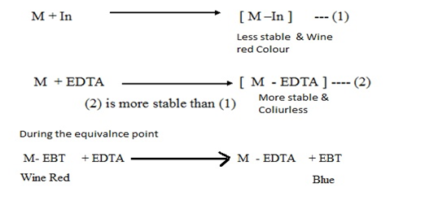

Slide 17
50 mL SHW = V₁ mL EDTA
50 x 1 mg of CaCO₃ = V1 mL EDTA
Hence, 1 mL EDTA = 50/V₁ mg CaCO₃ eq.
Now 50 mL of given hard water = V₂ mL of EDTA
= V₂ x 50/V₁ mg CaCO₃ eq.
1 L of given hard water = 20 x V₂ x 50/V₁ mg CaCO₃ eq.
Total Hardness of water = 1000 V₂/V₁ ppm
Now, 50 mL of boiled water = V₃ mL of EDTA
= V₃ x 50/V₁ mg CaCO₃ eq.
1 L of boiled hard water = 20 x V₃ x 50/V₁ mg CaCO₃ eq.
Permanent Hardness = 1000 V₃/V₁ ppm

Slide 18
Sample A = 14.6 mg of Mg(HCO₃)₂ per litre
Sample B = 820 mg of Ca(NO₃)₂ and 2 mg NaNO3
Sample C = 20 g Silica and 16.2 mg Ca(HCO₃)₂ per 500 ml
Determine the hardness of samples A, B, C ?

Slide 19
Hardness Numerical
Sr. No. | Type of impurity | Amount of impurity | Molecular mass | M.F. | Equivalence of Ca CO3 Hardness | Hardness Type
1 | Ca(HCO₃)₂ | 8.1 ppm | 162 | 100/162 | 5 ppm | T
2 | Mg(NO3)2 | 14.8 ppm | 148 | 100/ 148 | 10 ppm | P
3 | MgSO4 | 3 ppm | 120 | 100/120 | 2.5 ppm | P
4 | CaCl2 | 2.22 ppm | 111 | 100/111 | 2 ppm | P
5 | KNO3 | 5 ppm | --- | -- | -- | N.H.
6 | FeSO4.7H2O | 5.75 ppm | 278 | 100/278 | 2.06 ppm | P
7 | NaHCO3 | 3 ppm | -- | -- | -- | N.H
 | Temporary Hardness = 5 ppm
 | Permanent Hardness = 16.56 ppm
 | Total Hardness = 21.56 ppm

Slide 20
Numerical on EDTA method
0.28 g of CaCO₃ was dissolved in HCl and the solution is diluted to 1 litre.
100 mL of the above solution required 28 mL of EDTA solution.
100 mL of hard water sample required 33 mL of EDTA solution.
After boiling, cooling and filtration 100 mL of this solution on titration required 10 mL of EDTA solution. Calculate all types of hardness.

Slide 21
Numerical on EDTA method
b) 55.5 mg of CaCl₂ is dissolved in 750 ml of distilled water and 50 ml of this water on titration required 14 ml of EDTA.
100 ml of water sample on titration with same EDTA required 9.8 ml.
50 ml of boiled water sample on titration required 2.7 ml of same EDTA. Calculate the all types of hardness.

Slide 22
750 ml of SHW = 55.5 mg of CaCl₂
= (55.5 / 750) x 100/111 mg of CaCo₃
1 ml of SHW = 0.067 mg of CaCO₃
50 ml of SHW = 14 ml of EDTA
1 ml of EDTA = 50 /14 ml of SHW
= 50 /14 x 0.067 mg of CaCO₃
1 ml of EDTA = 0.24 mg of CaCO₃

Slide 23
Total Hardness
100 ml of water sample = 9.8 ml of EDTA = 9.8 x 0.24 mg of CaCO3
Total hardness = 9.8 x 0.24 x 1000/100 mg /L = 23.52 ppm or mg /l

Slide 24
c) 50 mL sample of water required 8.2 mL of M/20 Disodium EDTA solution for titration. After boiling and filtration the same volume required 4.5 mL of EDTA. Calculate all types of hardness.
M/20 EDTA = 0.05 M EDTA
1000 mL 1 M EDTA = 100 g CaCO₃
1 mL, 1 M EDTA = 100 mg CaCO₃
50 mL water sample = 8.2 mL of 0.05 M EDTA
1000 mL water sample = 20 x 8.2 M of 0.05 M EDTA
= 164 mL of 0.05 M EDTA
1 mL, 1 M EDTA = 100 mg CaCO₃
164 mL of 0.05 M EDTA = 164 x 0.05 x 100 = 820 ppm = Total Hardness

Slide 25
Now, 50 mL of boiled water = 4.5 mL of 0.05 M EDTA
1000 mL water sample = 20 x 4.5 M of 0.05 M EDTA
= 90 mL of 0.05 M EDTA
As, 1 mL, 1 M EDTA = 100 mg CaCO₃
90 mL of 0.05 M EDTA = 90 x 0.05 x 100 = 450 ppm = Permanent hardness
Temporary hardness = 820 – 450 = 370 ppm

Slide 26
d) 25 mL sample of water required 5.5 mL of M/10 Disodium EDTA solution for titration. After boiling and filtration 50 mL of water sample required 3.9 mL of EDTA. Calculate all types of hardness.

Slide 27
Softening Methods
Lime-Soda Method
Zeolite Softener method
Ion Exchange Method

Slide 28
Lime-Soda Method
In this method, calculated quantity of Lime [Ca(OH)₂] and Soda [Na₂CO₃] mixture is added to hard water.
Precipitates of CaCO₃ and Mg(OH)₂ are formed due to reactions of hardness causing salts with lime and soda.
These precipitates gets settled down in the form of sludge.
This settling of precipitates is faster in hot lime soda method compared to cold Lime soda method.
Hence for quick settling of particles of CaCO₃ and Mg(OH)_{2,} coagulants such as Alum [Al₂(SO₄)₃], sodium meta aluminate [NaAlO₂], or FeSO₄ could be used in cold lime soda method.

Slide 29
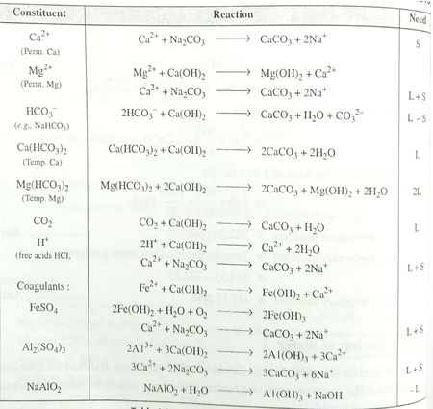

Slide 30
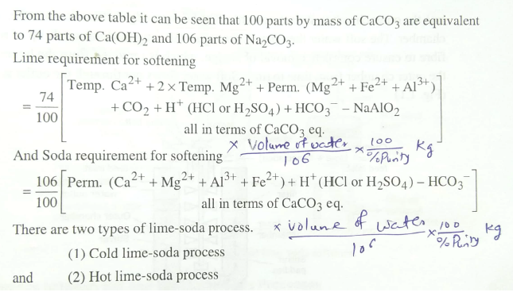

Slide 31
Cold Lime-Soda Method
In cold lime-soda method, hard water is treated with mixture of lime, soda and coagulants at room temperature about 25-30 ⁰C
Inner cylindrical reaction tank equipped with stirrer, which ensures complete mixing of lime, soda and coagulants with hard water
In outer conical sedimentation vessel, sludge settles down
Wood fiber filters ensures the complete removal of sludge particles from softened water

Slide 32
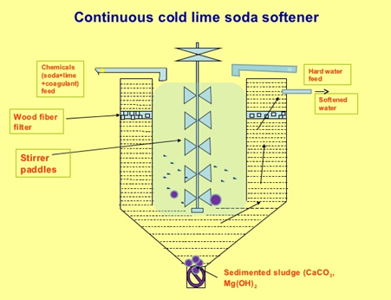
Cold Lime-Soda Method
Carried out at 25 ⁰C to 30 ⁰C
Coagulants required
Stirring is essential as the reaction is operated at low temperature
Slow process
Dissolved gases are not removed
Filtration is not easy
Residual hardness is 50-60 ppm
Low softening capacity

Slide 33
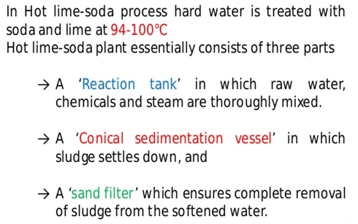
Hot Lime-Soda Method

Slide 34
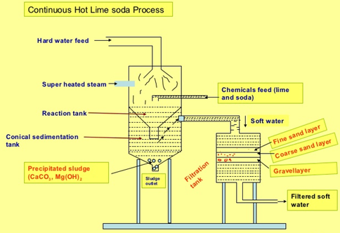
Hot Lime-Soda Method
Carried out at 95 ⁰C to 100 ⁰C
Coagulants are not required
Stirring is not essential as the reaction is operated at high temperature
Fast process
Dissolved gases gets removed due to high temperature
Filtration is easy, hence sand filter is sufficient
Residual hardness is 15-30 ppm
High softening capacity

Slide 35
Advantages of hot lime-soda method over cold lime-soda method
Economical process
pH value of softened water is high (Decrease corrosion)
Alkaline nature of treated water reduces pathogens, bacteria in water
Fe (II) and Mn (II) can also be removed to certain extent

Slide 36
Disadvantages of Lime-soda method
Softened water is 50 ppm hardness in cold lime-soda method and 15-30 ppm hardness in hot lime-soda method.
Such water can not be used in high pressure boilers
Disposal of large quantity of sludge is a big problem

Slide 37
Zeolite Softener Method
Sodium-Zeolites which are hydrated sodium alumino silicates, capable of exchanging their sodium ions with hardness producing ions are used.
Chemically sodium zeolites are Na₂O.Al₂O₃.xSiO₂.yH₂O
(Where, x= 2-10 & y= 2-6).
Principle: hard water passed over zeolite, it exchanges its own sodium ions with hardness causing ions.
2Na⁺ ions are generally exchanged with each bivalent hardness producing ions.

Slide 38
Process
For softening, hard water is passed over zeolite bed at specific rate
The hardness causing ions will be retained on zeolite and they are exchanged with equivalent sodium ions
After certain usage zeolite gets exhausted as all the sodium ions got exchanged
Such exhausted zeolite is regenerated by passing 10 % brine solution over it
This regenerates the zeolite by replacing hardness causing ions with Na⁺ ions to become Na-zeolite
Hence softening and regeneration are exactly opposite reactions

Slide 39
Reactions
Softening:
For softening of hard water, it is passed over sodium zeolite bed. Exchange of hardness causing ions takes place with sodium ions present on zeolite. The following reactions takes place.
CaCl₂ + Na₂Ze CaZe + 2NaCl
MgSO₄ + Na₂Ze MgZe + Na₂SO₄
Regeneration:
For regeneration of exhausted zeolite, 10 % brine solution is passed over used zeolite.
CaZe + 2NaCl CaCl₂ + Na₂Ze
MgZe + 2NaCl MgCl₂ + Na₂Ze

Slide 40
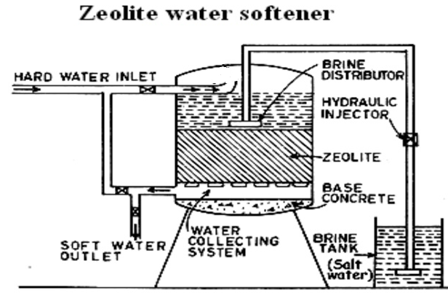

Slide 41
Advantages
Water obtained after treatment is about 10 ppm hardness
No sludge formation is taking place
Equipment is compact and easy in operation
Equipment occupies less space and low in maintenance

Slide 42
Limitations and Disadvantages of Zeolite softener method
Limitations
Suspended impurities blocks the pores of zeolite
Colored ions such as Fe³⁺ and Mn²⁺ forms strong bonds with zeolite hence can not be removed while regeneration from zeolite
Mineral acids can destroy zeolite
Disadvantages
The treated water is high in sodium salts
Only cations could be removed leaving behind anions in water

Slide 43
Ion Exchange softener method (De-mineralization process)
Ion exchange resins are insoluble, cross-linked, long chain organic polymers with micro-porous structure. The functional groups attached to the chains are responsible for ion exchanging property.
Cation Exchanger resins (RH⁺) :
Resins containing acidic functional groups (-COOH, -SO₃H etc.) are capable of exchanging their H⁺ ions with other cations in hard water.
Anion Exchanger resins (ROH⁻) :
Resins containing basic functional groups (-NH₂-OH, =NH-OH, -NMe₂-OH etc.) are capable of exchanging their OH⁻ with other anions in hard water.

Slide 44
Process - Softening
For softening, hard water is first passed over cations exchanger resin column at specific rate, which removes cations like Ca²⁺, Mg²⁺ etc. from hard water.
The hardness causing ions will be retained on cation exchanger resin and they are exchanged with equivalent amount of H⁺ ions
Further, the softened water from cation exchanger column is passed through anion exchanger column, which removes anions like, SO₄²⁻, Cl⁻, CO₃²⁻ etc. with equivalent amount of OH⁻ ions from the resin.
H⁺ and OH⁻ ions from resin columns combines to form water.
Softening
2 RH⁺ + CaCl₂ R₂Ca²⁺ + 2HCl
2 RH⁺ + MgSO₄ R₂Mg²⁺ + H₂SO₄
2 ROH⁻ + 2Cl⁻ R₂Cl⁻ + 2 OH⁻
2 ROH⁻ + SO₄²⁻ R₂SO₄²⁻ + 2 OH⁻

Slide 45
Process - Regeneration
After certain usage both cation and anion exchanger resins gets exhausted and they can not exchange any more cations or anions.
Exhausted cation exchanger resin is regenerated by passing dil. HCl solution
Exhausted anion exchanger resin is regenerated by passing dil. NaOH solution
This regenerates both the resins making the method reusable.
Regeneration
R₂Ca²⁺ + 2HCl 2 RH⁺ + CaCl₂
R₂Mg²⁺ + H₂SO₄ 2 RH⁺ + MgSO₄
R₂Cl⁻ + 2 NaOH 2 ROH⁻ + 2NaCl
R₂SO₄²⁻ + 2 NaOH 2 ROH⁻ + Na₂SO₄

Slide 46
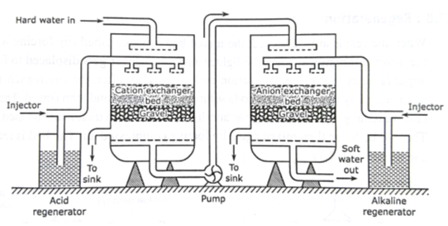
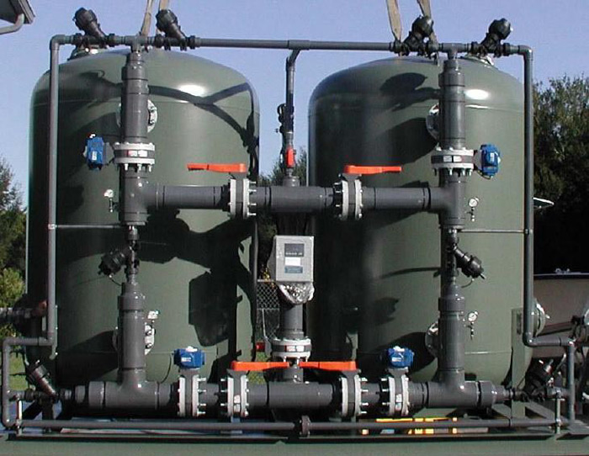
Ion Exchange Softener
(Commercial plant)

Slide 47
Advantages
The process can be used for highly acidic or alkaline water.
It produces water of very low hardness (less than 2 ppm).
Softened water can be used in steam generation boiler.
Disadvantages
The equipment is costly and expensive resins are required.
Turbid water could decrease the efficiency of the method. Hence turbidity need to be removed first by coagulation and then water could be passed over the resin.

Slide 48
BOD (Biological Oxygen Demand)
It is a measure of amount of oxygen required for the biological oxidation of organic matter under aerobic conditions at 20⁰ C for a period of 5 days.
Organic matter + O₂ Micro-organisms CO₂ + H₂O
BOD is the direct measurement of extent of pollution in waste water & industrial effluent.
Only applicable for bio-degradable pollutants.
Higher the BOD, higher will be the level of pollutants in water.
Drinking water should have BOD less than 1 ppm.

Slide 49

Principle
Dissolved oxygen content of diluted waste-water is determined at the beginning of the reaction by Winkler’s method or by DO meter.
Same sample of water is kept for incubation in the presence of micro-organisms for 5 days at 20⁰ C and decrease in the dissolved oxygen content is determined by Winkler’s method or by DO meter.
BOD = [(DO)_{Blank} – (DO)_{Incubated} ] X Dilution Factor
(DO)_{Blank} = Dissolved oxygen of diluted sample in the beginning of the reaction
(DO)_{Incubated} = Dissolved oxygen of diluted sample after incubation for 5 days at 20 ⁰ C.

Slide 50
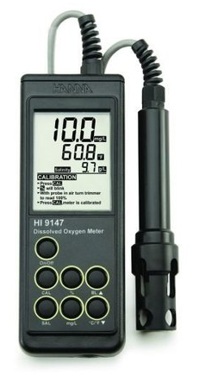
BOD Meter

Slide 51
Significance of BOD
BOD gives the extent of bio-degradable pollutants in wastewater sample
It also helps in pollution control in water
It also express self-purification capacity of any water body.

Slide 52
COD (Chemical Oxygen Demand)
It is a measure of amount of oxygen required for the chemical oxidation of organic matter when refluxed in acidified potassium dichromate in the presence of Ag₂SO₄ or HgSO₄ catalyst for 3 hours.
CxHyOz + (X + Y/4 – Z/2) O₂ X CO₂ + (Y/2) H₂O
(Organic matter) [O]
COD is the direct measurement of extent of pollution in waste water & industrial effluent.
Applicable for both bio-degradable and non bio-degradable pollutants.
Higher the COD, higher will be the level of pollutants in water.
Drinking water should have COD less than 1 ppm.

Slide 53
Principle
A known volume of waste water sample (say 250 ml) is refluxed with a known excess of standard potassium dichromate (1 N) and dilute/conc. sulfuric acid mixture in the presence of silver sulphate catalyst for about 3 hours.
This oxidases organic matter to CO₂, NH₃ and H₂O.
The unreacted potassium dichromate is titrated against Ferrous ammonium sulphate (Mohr’s salt) with ferroin indicator till blue colour changes to wine red, the reading is (Vt).
This gives the amount of potassium dichromate consumed (in terms of equivalent oxygen) required for degradation of organic pollutants.
Blank titration is performed initially with known volume of waste water sample and added acidified standard potassium dichromate titrated against Ferrous ammonium sulphate (Mohr’s salt) with ferroin indicator till blue colour changes to wine red, the reading is (Vb) (zero minute reading)

Slide 54
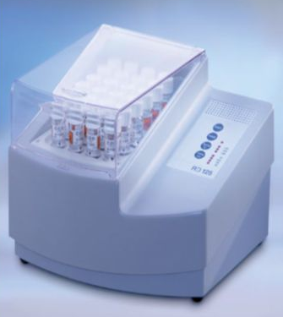
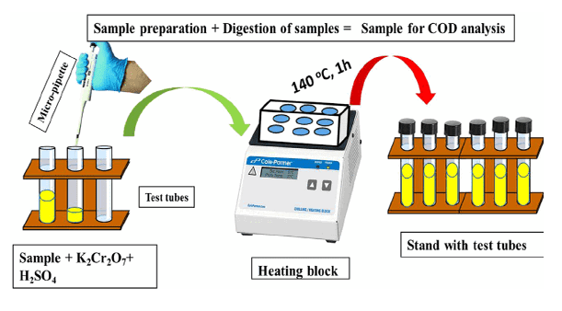
COD Meter

Slide 55
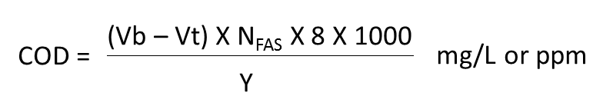
Principle
Vb = Volume of FAS required for blank titration (Zero time)
Vt = Volume of FAS required for reaction mass after time (t)
Y = Volume of waste water sample taken

Slide 56
Significance of COD
COD gives the extent of pollution caused by bio-degradable and non bio-degradable pollutants in wastewater sample
It helps in rapid determination of pollutants level in water compared to BOD
It is taken as a basis for calculation of efficiency and designing of water treatment plants.

Slide 57
Comparison between BOD and COD
BOD | COD
It measures oxygen demand of bio-degradable organic pollutants only | It measures oxygen demand of bio-degradable and non biodegradable organic pollutants
Less stable measurement technique as micro-organisms are susceptible to variables such as pH and temperature | More stable measurement technique as no micro-organisms are used and potassium dichromate oxidizes any type of organic pollutants in water
Slow process, takes 5 days | Fast process , takes 3 hours
BOD values are generally less than COD values | COD values are generally greater than BOD values

Slide 58
Formulae
1. BOD = [(DO)_{Blank} – (DO)_{Incubated} ] x Dilution Factor
(DO)_{Blank} = Dissolved oxygen of diluted sample in the beginning of the reaction
(DO)_{Incubated} = Dissolved oxygen of diluted sample after incubation for 5 days at 20 ⁰ C.
2.
Vb = Volume of FAS required for blank titration (Zero time)
Vt = Volume of FAS required for reaction mass after time (t)
Y = Volume of waste water sample taken

Slide 59
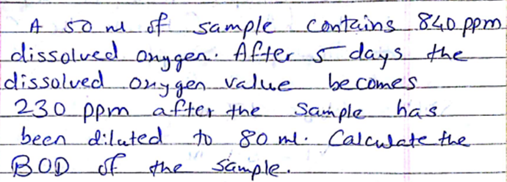

Slide 60
